Slide 1
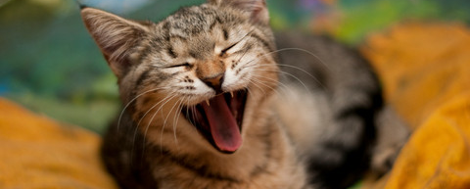
One person Team?
SCRUM for One.
Using XP practices alone

Slide 2

Rubiks Cube
Du har brug for en algoritme
https://ruwix.com/the-rubiks-cube/algorithm/

Slide 3
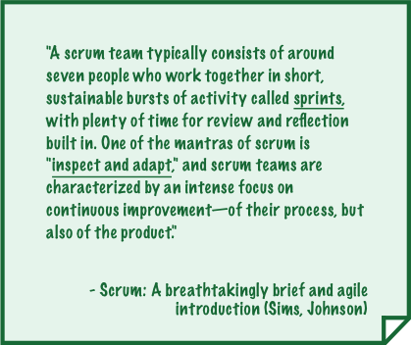
Scrum
Ship and share
Prioritize productivity, and quantify it
Self-reflection & meaningful iteration

Slide 4
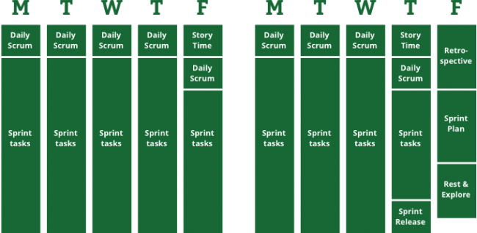
Scrum of One – an example
Big picture 45 min
Video 1 min
Make it better
Goals
Backlog
To some one else
Work related

Slide 5



Go somewhere else
Finally, based on your reflections, pick two simple things to improve on in your next sprint:
One thing to make you more productive.
One thing to make you happier.

Slide 6
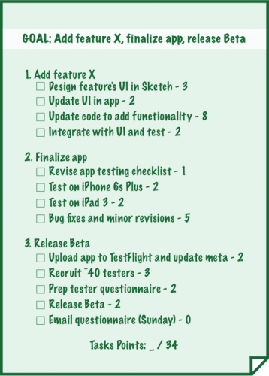

Slide 7
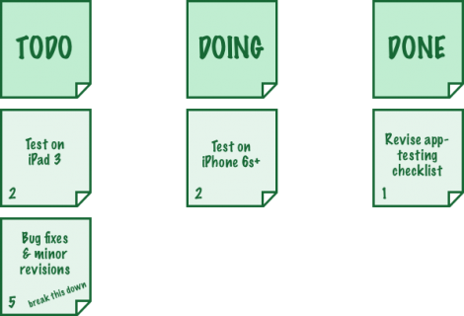
Taskboard

Slide 8
Der er også et bud på XP
https://www.researchgate.net/publication/220996614_Extreme_programming_for_a_single_person_team

Slide 9
Litteratur
https://www.raywenderlich.com/162654/scrum-one-bring-scrum-one-person-operation
https://www.researchgate.net/publication/220996614_Extreme_programming_for_a_single_person_team

